Slide 1
Welcome to
Our Sunday School
We’ll start at 9:07
visit OurSundaySchool.com for more about our class

Slide 2
Today’s class (pages 76-79)
Philippians 1:21

Slide 3
Philippians 1:21 (CSB)
For me, to live is Christ and to die is gain.

Slide 4
Today’s class (pages 76-79)
Philippians 1:21

Slide 5
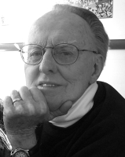
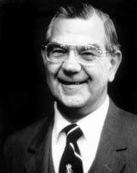
Dr. G. F. Hawthorne & Dr. Ralph P. Martin accentuating the process of living… accentuating the act of dying

Slide 6
Today’s class (pages 76-79)
Philippians 1:21

Slide 7
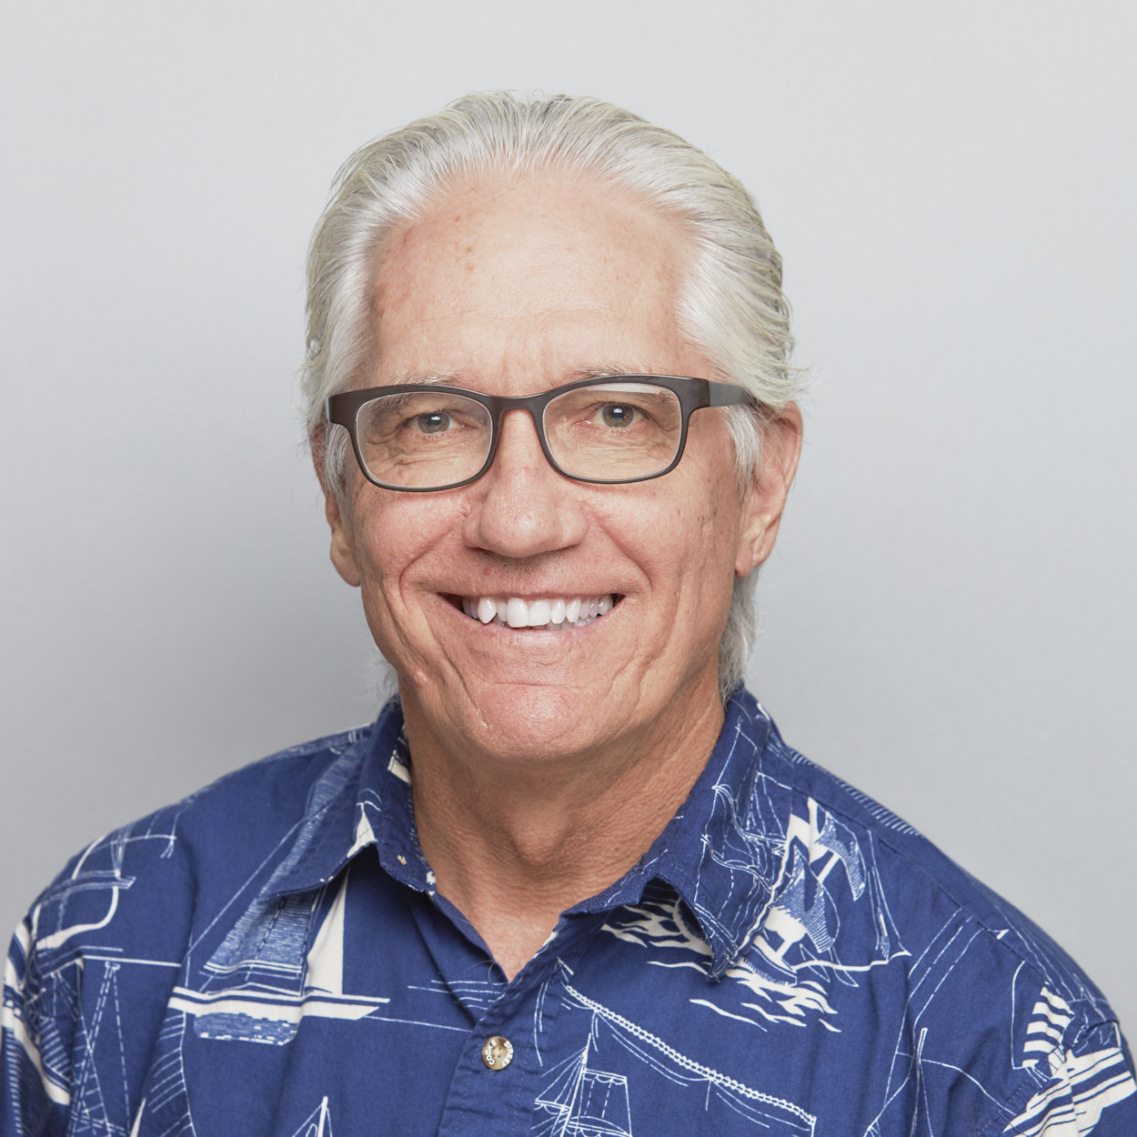
Dr. Joe Hellerman Death is gain for Paul, not because it provides an escape from his troubles but because it means being “with Christ” (v. 23).

Slide 8
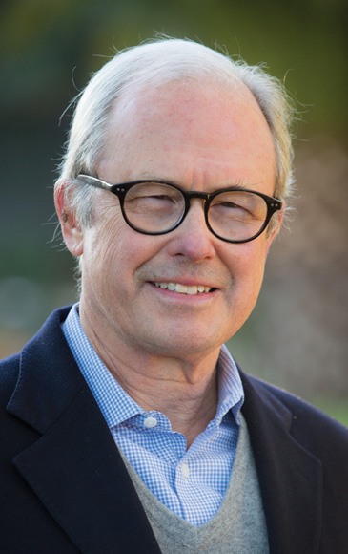
Dr. G. Walter Hansen Paul viewed his suffering and death as a gain for the advance of the gospel because he expected that his death would be his final and most effective witness for Christ.

Slide 9
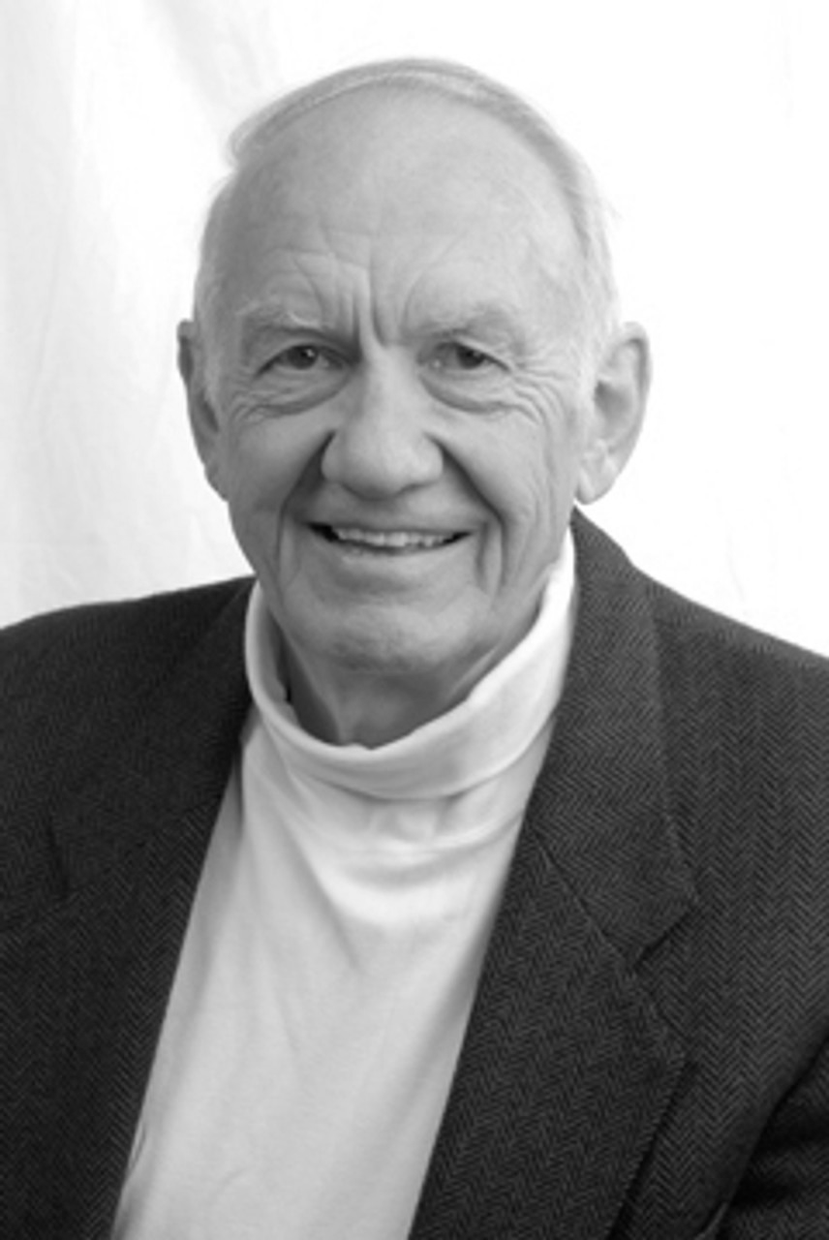
Dr. Gordon Fee Those of us in a predominantly reading culture sometimes forget… these words were primarily experienced by hearing them read, not by reading.

Slide 10
Dr. Gordon Fee to zēn Christos to apothanein kerdos = to live Christ to die gain

Slide 11
Dr. Gordon Fee to zēn Christos to apothanein kerdos = to live Christ to die gain

Slide 12
Dr. Gordon Fee May 23, 1934 - October 25, 2022

Slide 13
O For a Thousand Tongues to Sing
O for a thousand tongues to sing
my dear Redeemer’s praise!
The glories of my God and King,
the triumphs of his grace.

Slide 14
O For a Thousand Tongues to Sing
My gracious Master and my God,
assist me to proclaim,
to spread through all the earth abroad
the honors of thy name.

Slide 15
O For a Thousand Tongues to Sing
Jesus! the name that charms our fears,
that bids our sorrows cease;
‘tis music in the sinner’s ears,
‘tis life, and health, and peace!

Slide 16
O For a Thousand Tongues to Sing
He breaks the power of canceled sin,
he sets the prisoner free;
his blood can make the foulest clean;
his blood availed for me.

Slide 17
Prayer Time
Write down your prayer requests (on the Weekly Update or in the comments)
Lean in, engage, and pray for someone not with you
Go worship

Slide 18
Today’s class (page 16)
Preparing for Philippians 1:1-30
Pray with others
Hear with others
Think with others
Study with others In class, as a table
Share with others
Invite others After class
In class, as a class

Slide 19
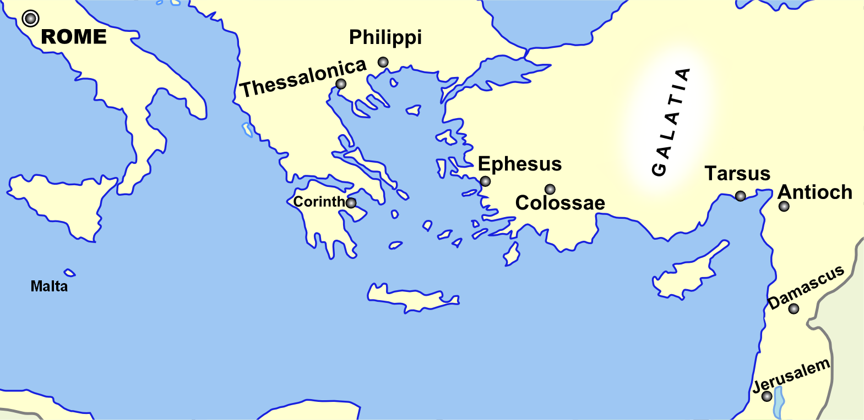
Monozigote. (2012). Broad Overview of Geography Relevant to Paul of Tarsus [Map]. Wikipedia.

Slide 20
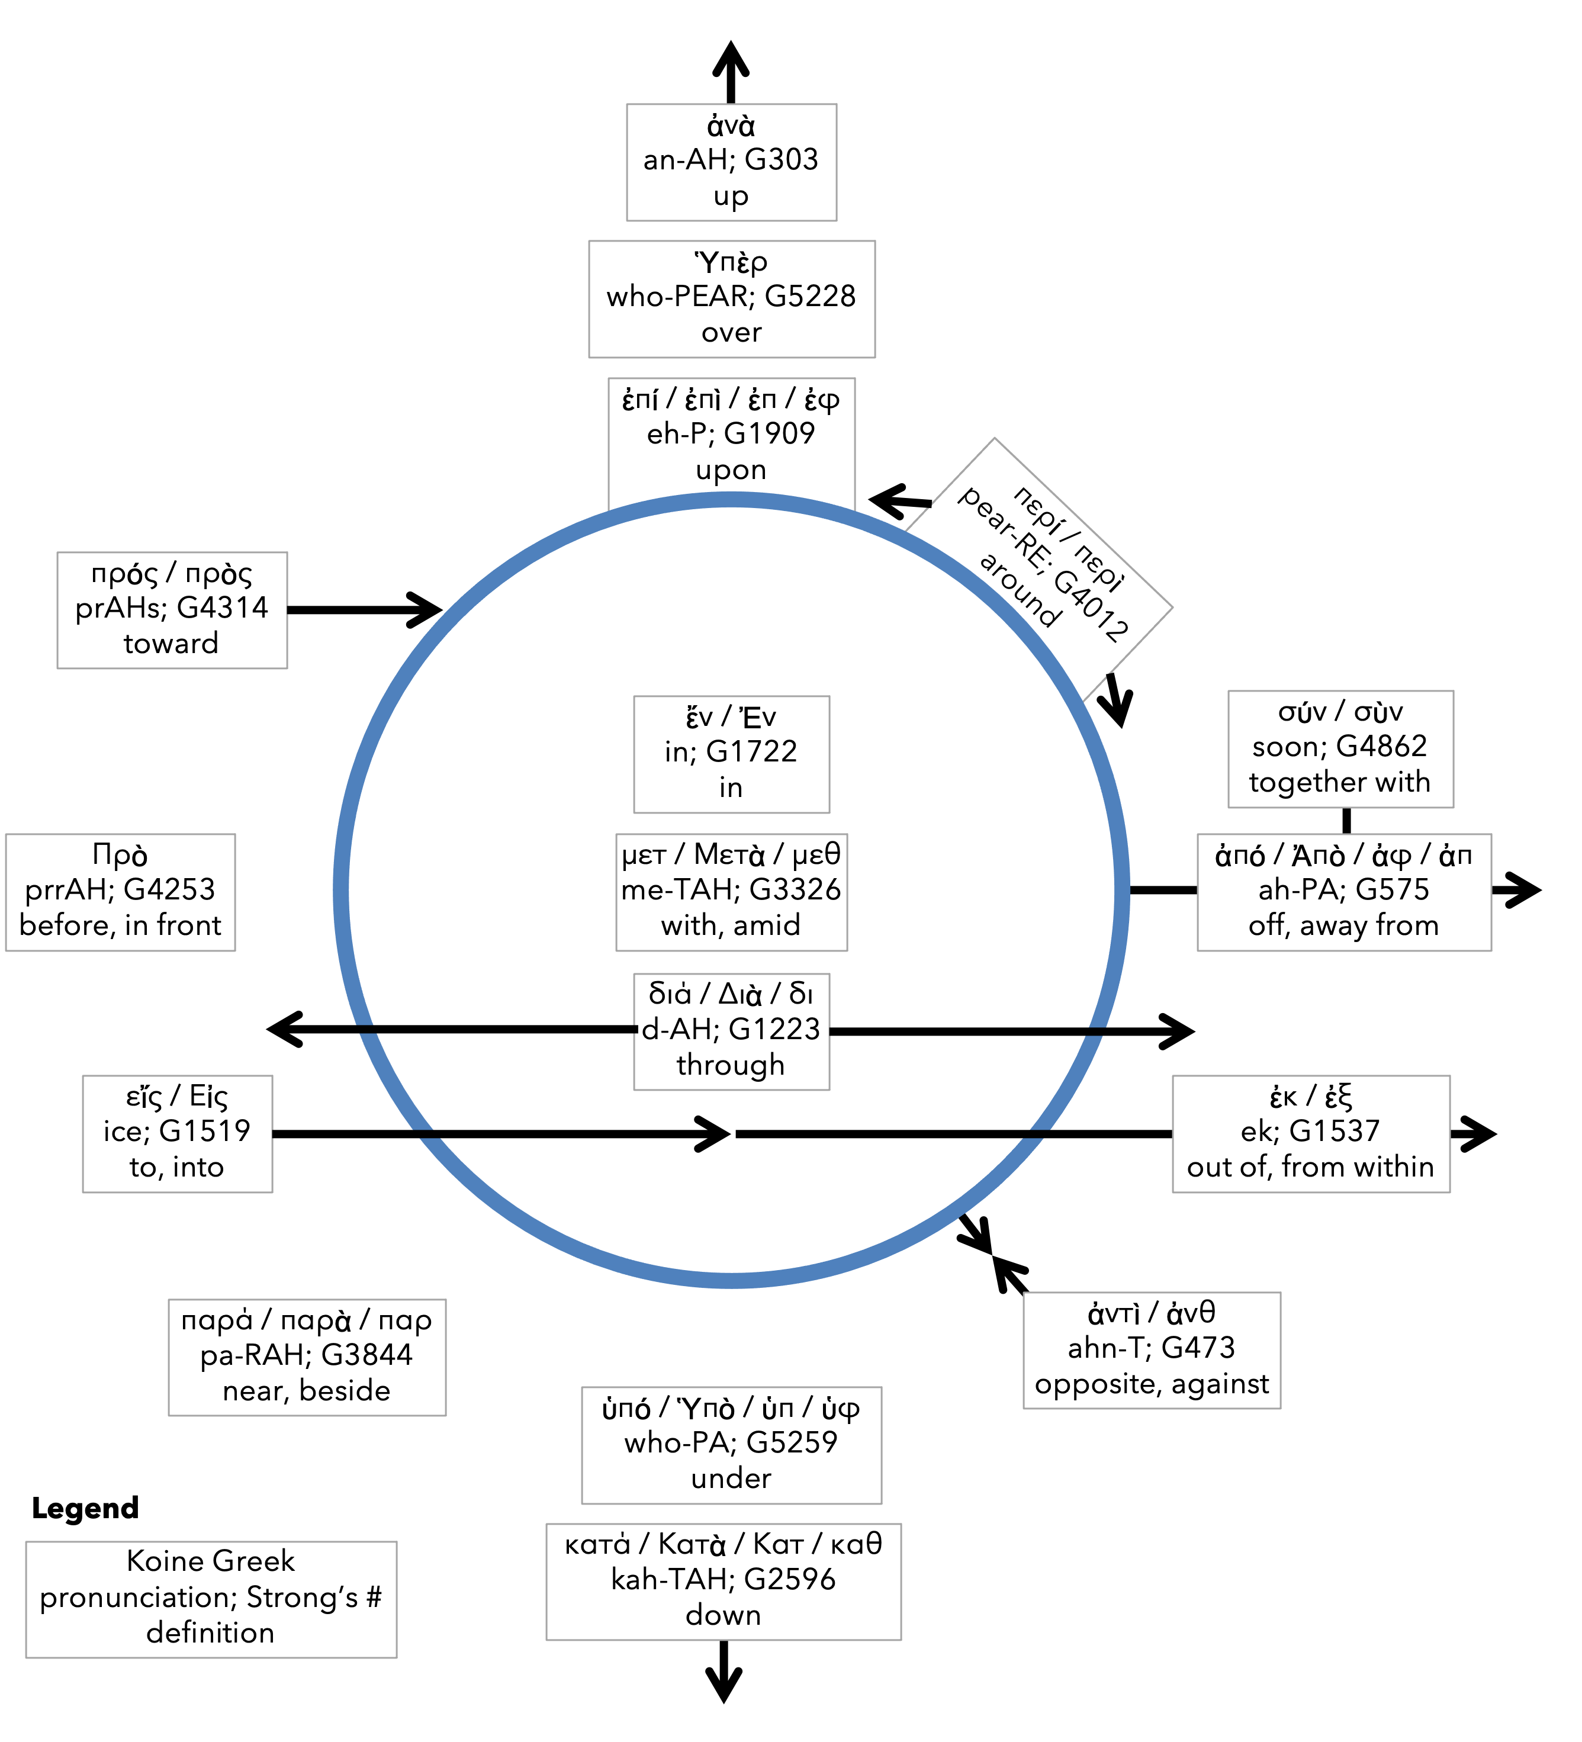
Preposition circle (page 11)

Slide 21
Dr. Gordon Fee …a distinguishable part of the whole, but as part of the whole, not above or outside it

Slide 22
Dr. G. Walter Hansen …a distinguishable part of the whole, but as part of the whole, not above or outside it

Slide 23
Dr. G. F. Hawthorne & Dr. Ralph P. Martin Paul can see it no other way: as the master was, so must the servant be.

Slide 24
Dr. Joe Hellerman The pacification of the known world by the Romans was known as the pax Romana/ Augusta. The ideology of universal peace and prosperity

Slide 25
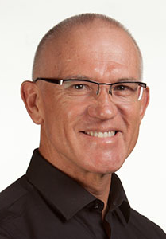
Dr. Mark Keown The pacification of the known world by the Romans was known as the pax Romana/ Augusta. The ideology of universal peace and prosperity under

Slide 26
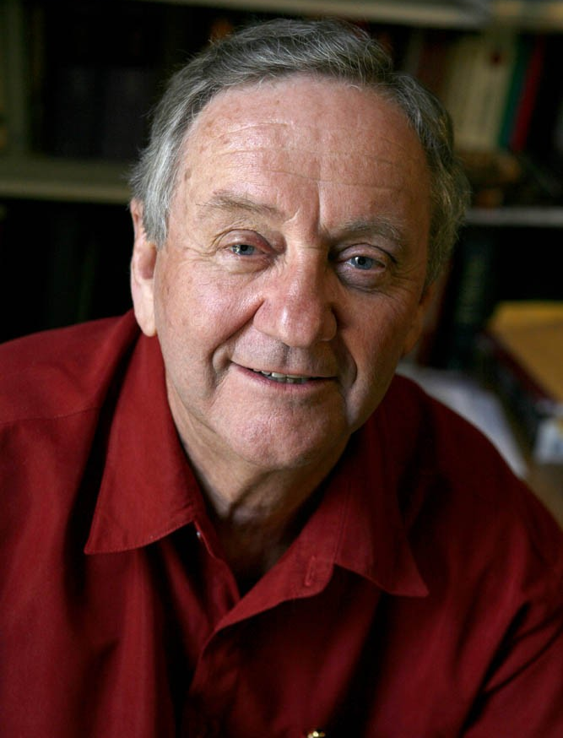
Dr. Peter T. O’Brien The pacification of the known world by the Romans was known as the pax Romana/ Augusta. The ideology of universal peace and prosperity under

Slide 27
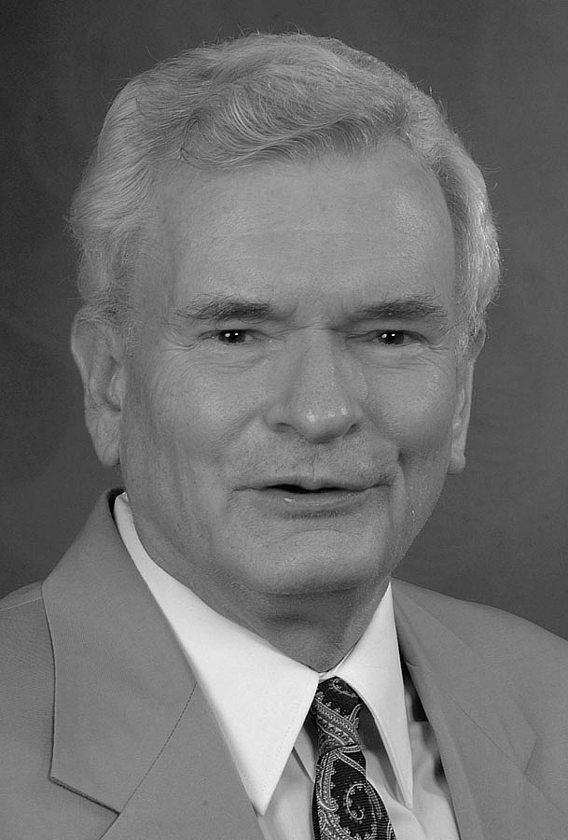
Dr. John Reumann Christ Jesus provides the basis for their relation to God, “glue” for their connections with each other, the sphere for their life and endeavors

Slide 28
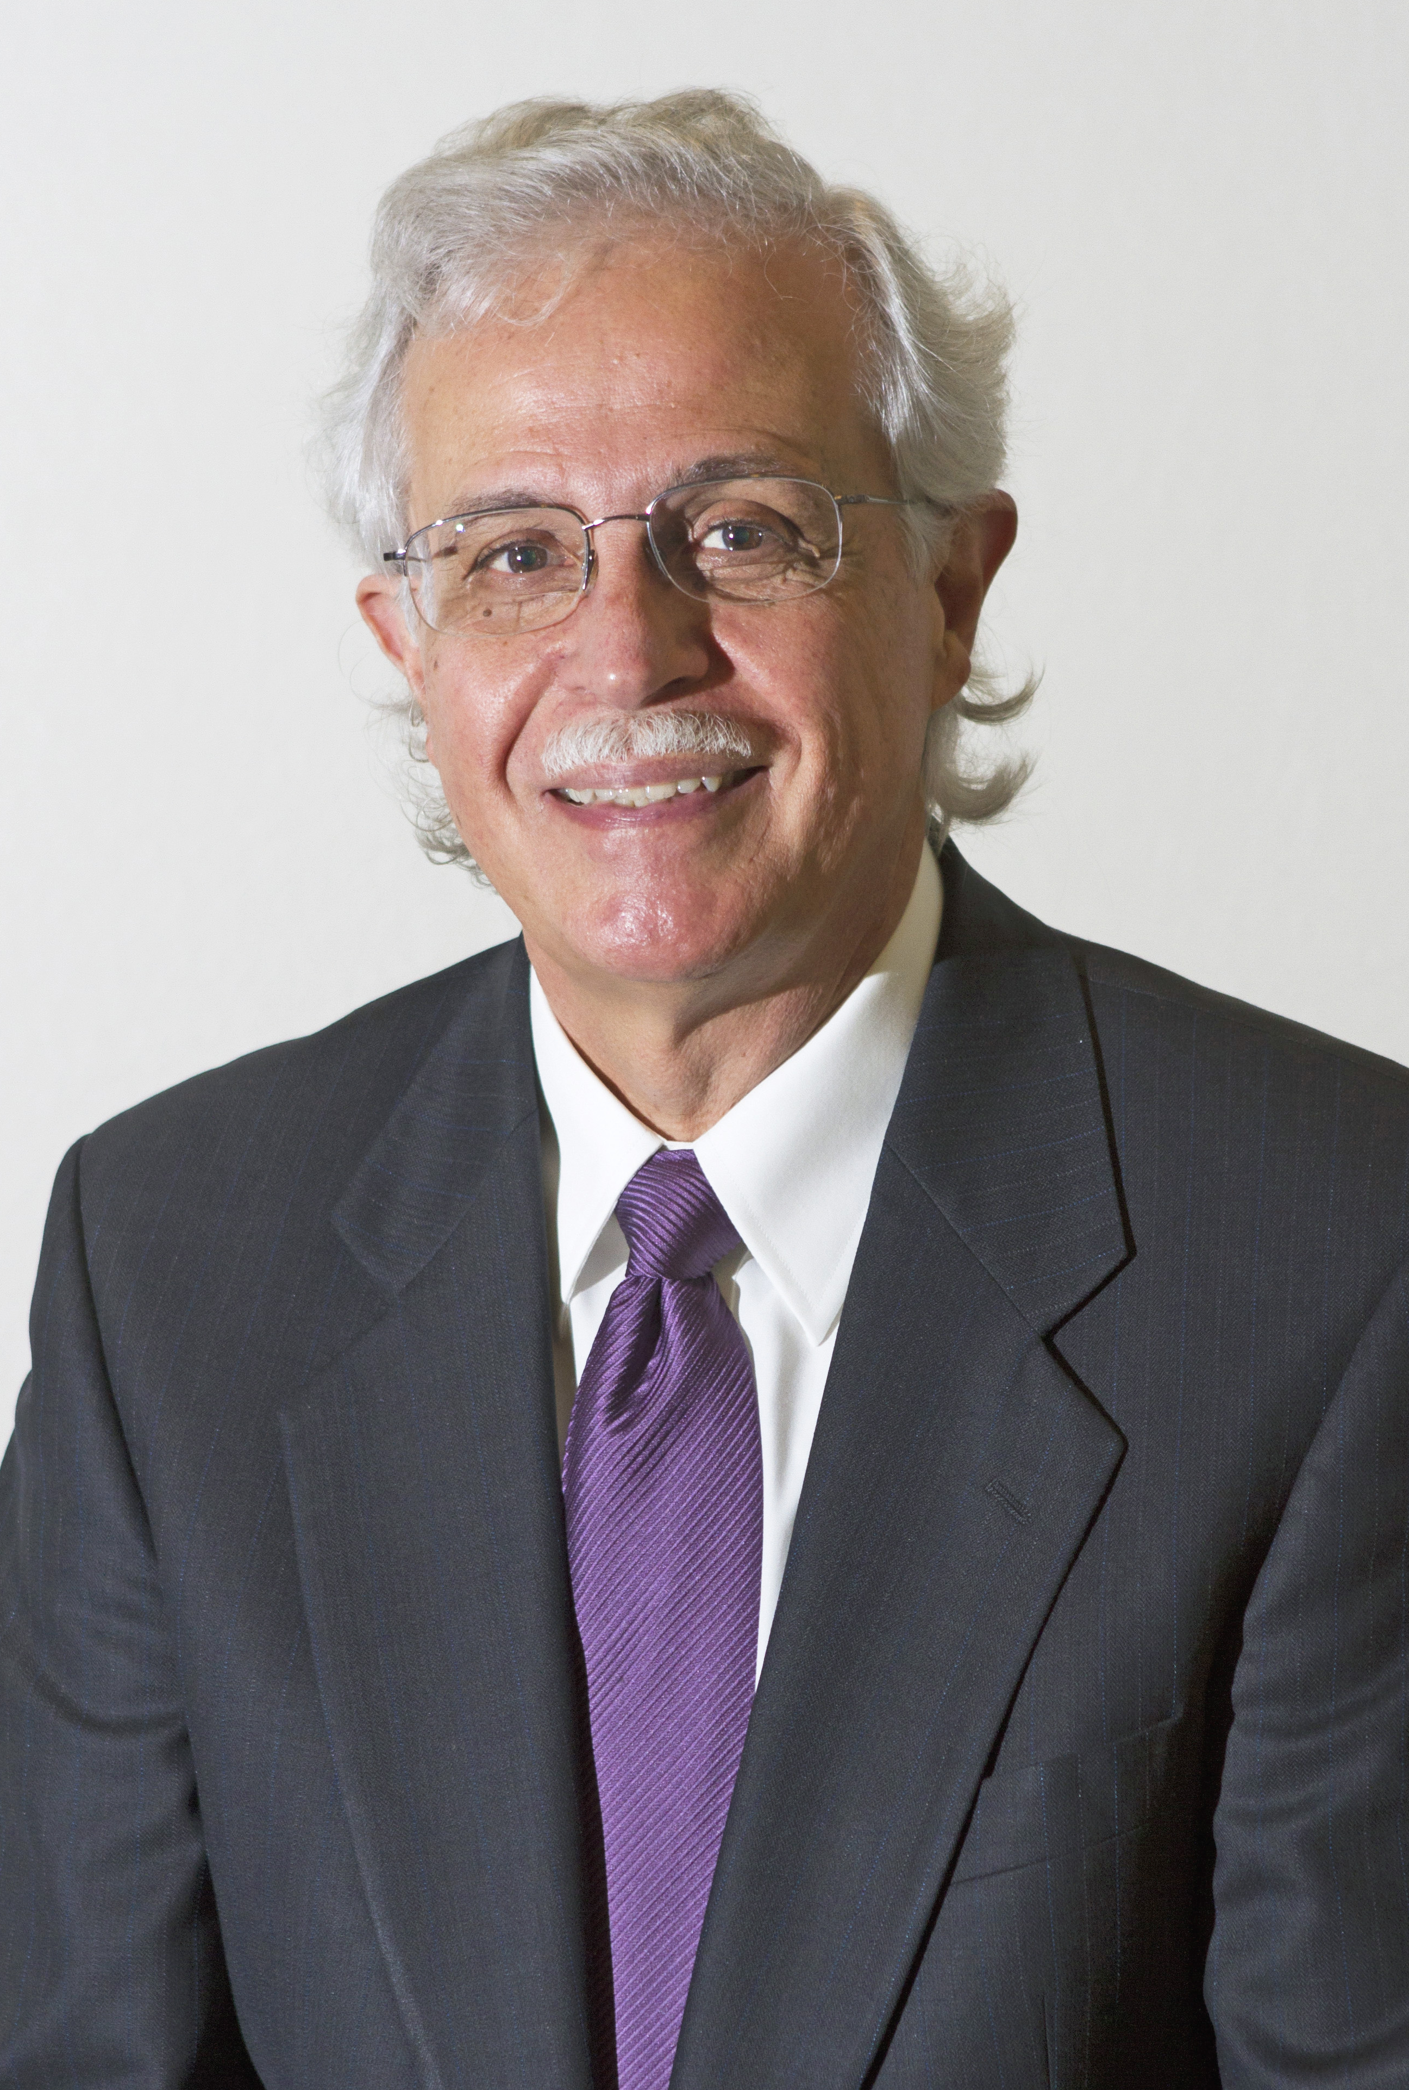
Dr. Moises Silva Christ Jesus provides the basis for their relation to God, “glue” for their connections with each other, the sphere for their life and endeavors

Slide 29
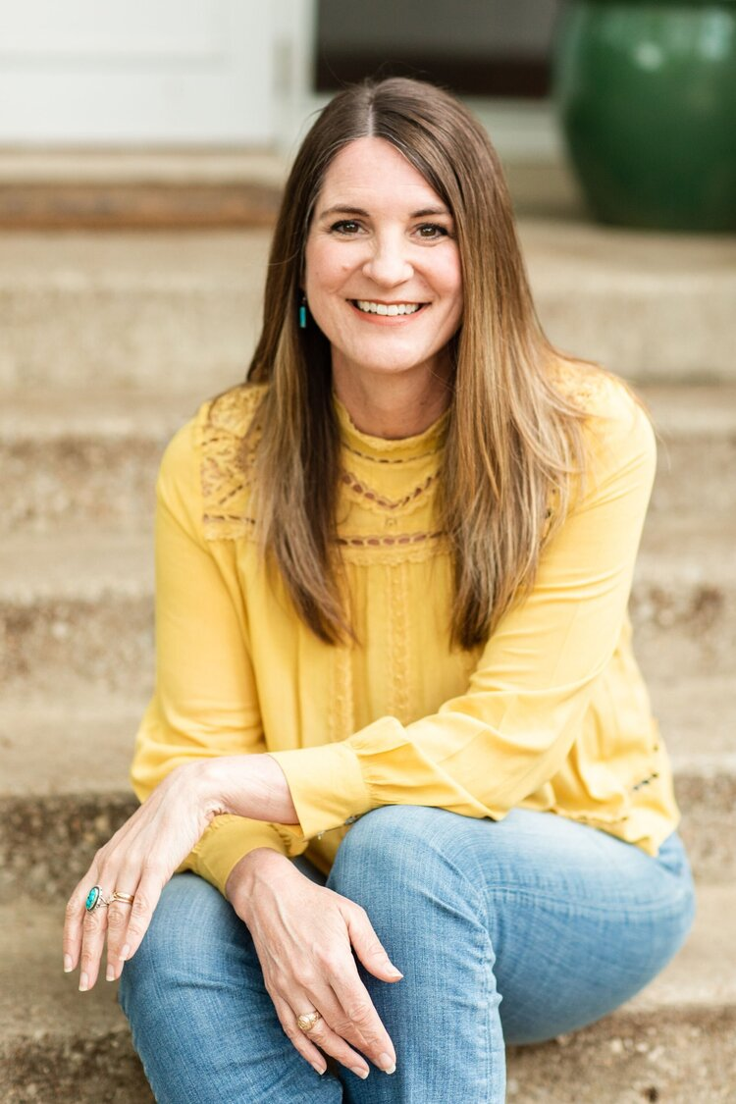
Jen Wilkin The heart cannot love what the mind does not know.

